Slide 1
THE BATTLE OF NEIGHBORHOODS
EXPLORING THE NEW DELHI CITY

Slide 2
INTRODUCTION
Being the greatest HubSpot of some of the most exquisite cuisines and lip-smacking local food from every corner of the world, New Delhi, the national capital of India, is proud to have some of the most unique and best restaurants within its lap. Any cuisine, Indian or International, name it and they have it. In this project, we will explore the neighbourhood of New Delhi city and find out the best restaurants for certain cuisines.
The foodies being the target audience of this project idea, we will seek answers to some of the following questions:
What places have best restaurants in New Delhi?
Which areas have lesser number of restaurants in the city?
Which is the best location for Chinese cuisine in New Delhi?
Which is the best location to stay if one prefers Chinese cuisine?
Where can we find large number of Chinese restaurants in the city?

Slide 3
DATA
The following data is used to solve the above-mentioned problem:
Source: https://www.kaggle.com/shrutimehta/zomato-restaurants-data
The dataset contains locality, restaurants, cuisines, ratings of the restaurants around the world along with their latitude and longitude. We extract the data of New Delhi using the latitude and longitudes provided.
Source: https://developer.foursquare.com/
We use the Foursquare API to explore the neighbourhood of New Delhi and find the answers to some obvious question for the audience.

Slide 4
Methodology
After collecting the dataset, we extract the data of New Delhi from the Kaggle dataset. We transform the data and clean the given data set by removing the columns which seem to be of less importance. When data cleaning is completed, we use the Foursquare API to explore the nearby venues for each neighbourhood in New Delhi.
We visualize the nearby venues of New Delhi using folium. We then filter the venues to find out the best restaurants around the city and the locality with highest as well as lowest number of restaurants.
We also find the places with highest number of Chinese restaurants and the best places for Chinese cuisine lovers to eat. We transform the data by grouping them based on their locality and analyse them in order to cluster the data.
We then cluster the most common venues in the neighbourhood into five clusters using K-Means Clustering machine learning algorithm and view the clusters formed. These clusters help the foodies to easily locate the places based on common venues and find a suitable place to stay to have delicious food within their reach.

Slide 5
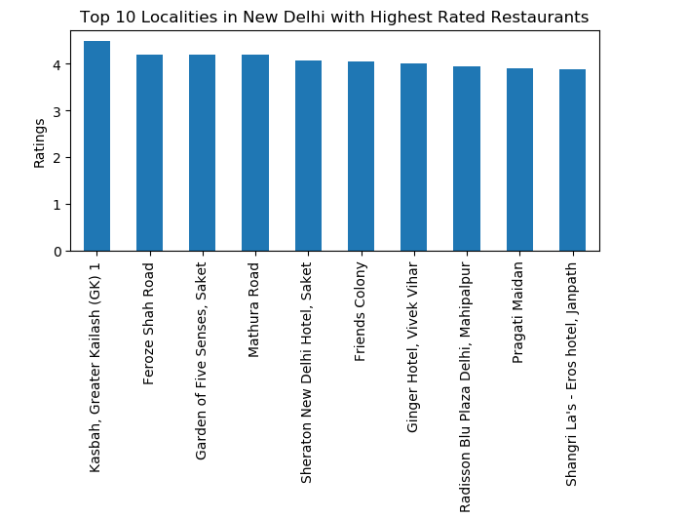
RESULTS

Slide 6
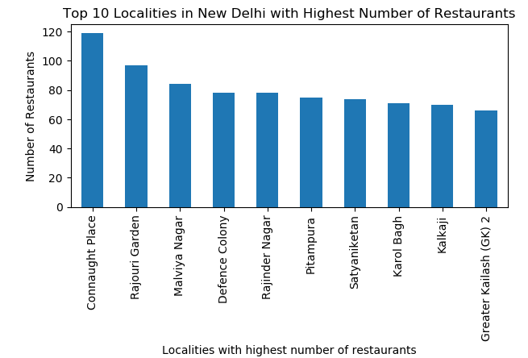
RESULTS (CONTINUED)

Slide 7
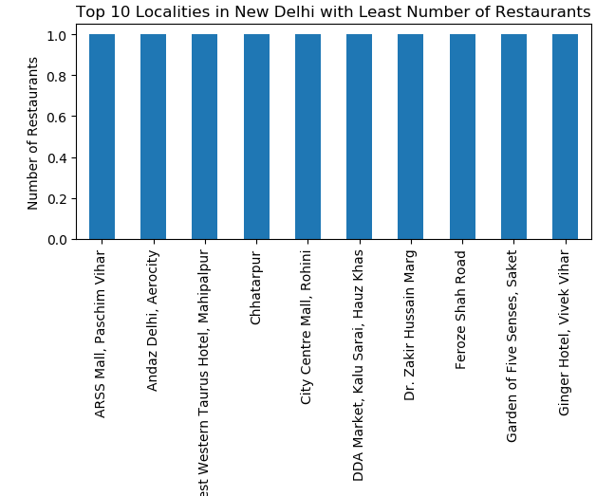
RESULTS (CONTINUED)

Slide 8
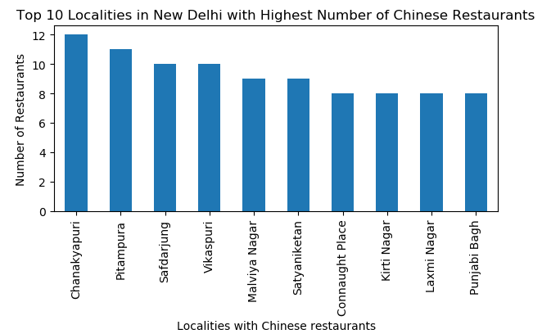
RESULTS (CONTINUED)

Slide 9
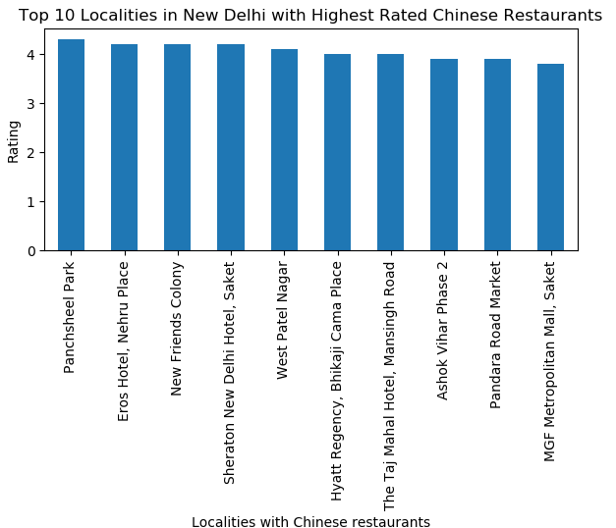
RESULTS (CONTINUED)

Slide 10
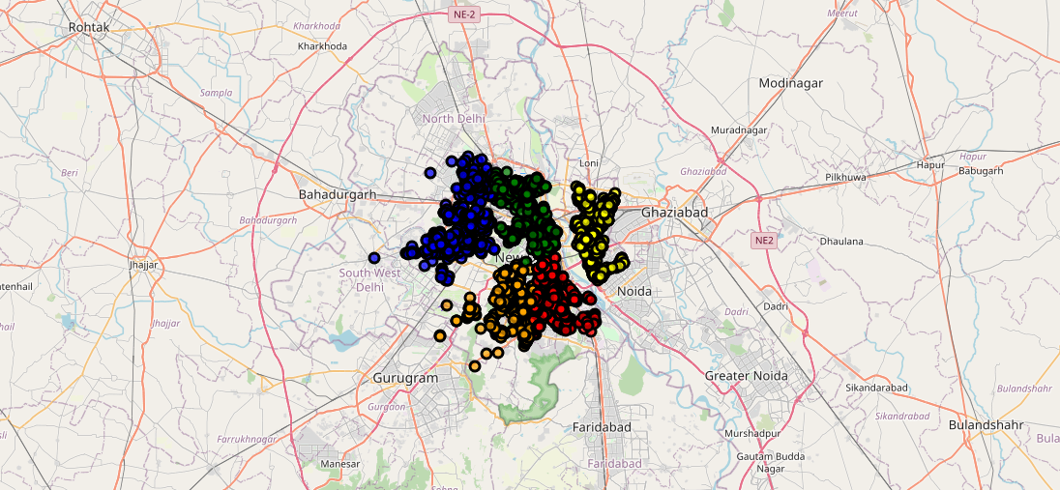
RESULTS (CONTINUED)

Slide 11
DISCUSSION
Based on the results obtained by clustering the data, we recommend:
Cluster 1 for Indian restaurants
Cluster 2 for Pizza Place
Cluster 3 for Coffee Shops and Cafes
Cluster 4 for Hotels
Cluster 5 for Cafes

Slide 12
CONCLUSION
Based on the results, we conclude that best restaurants can be found in Kasbah, Greater Kailash. Connaught Place has highest number of restaurants while ARSS Mall, Pashchim Vihar has the least. Chanakyapuri has a lot of Chinese restaurants but Panchsheel park has the best Chinese restaurants. Upon clustering using K-Means, we found the most common recommended venues for each cluster which will help the foodies to choose the best spot to reside in based on their interests.

